Slide 1


Statistics for Data Science

Slide 2

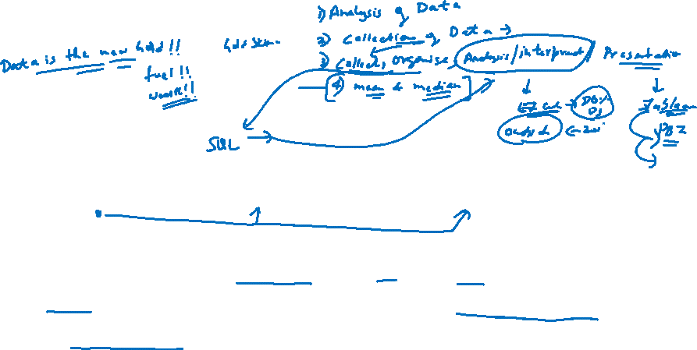
What is Statistics ?
Statistics is simply the study of data, facts, figures and measurements. Statistics is used to convert raw numerical data into useful information for relevant users.

Slide 3





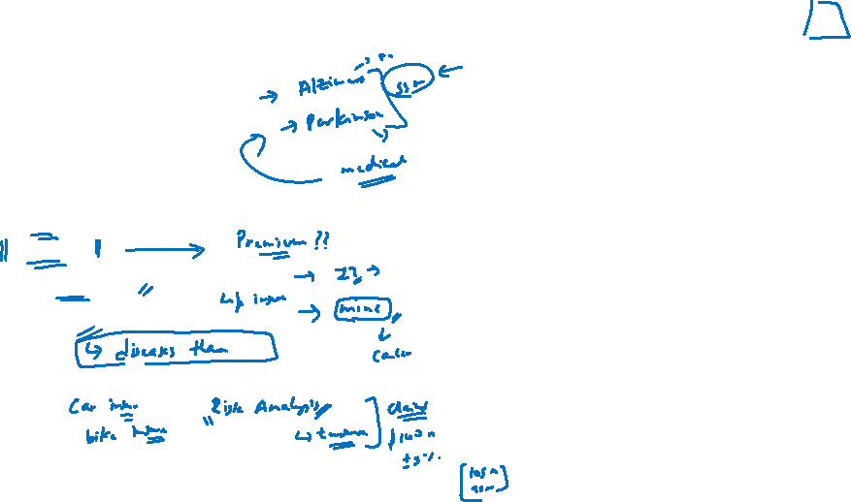
Some examples of how statistics shape our life
Weather Forecast
Stock Markets
Predicting emergencies
Political Campaigns
Insurance
Medical Studies
Genetics

Slide 4
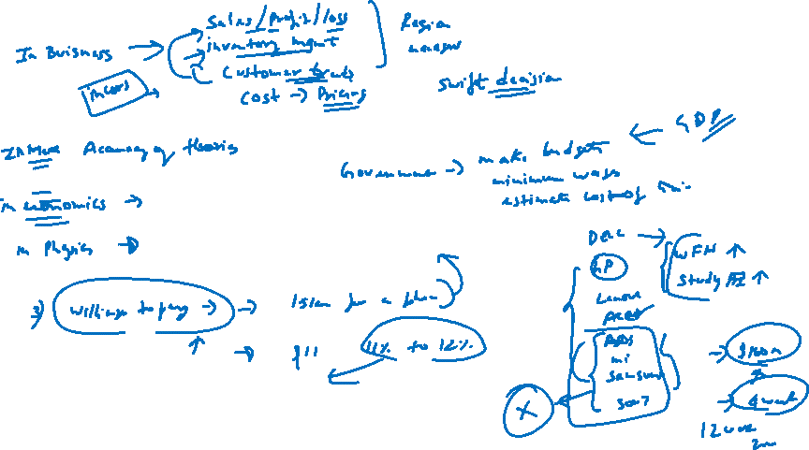
Worksheet

Slide 5
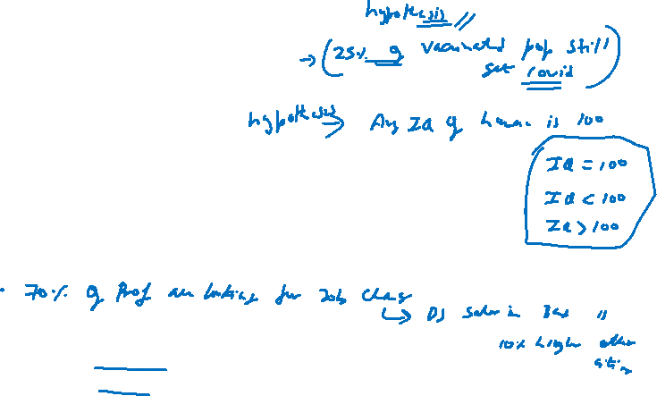
Some statistical statements
I drive my car at an average speed of 50 km/hr.
A survey of 1000 adults by a capital markets company showed that 75% of adults think that Corona vaccine is 96% efficacy (if that is the case then 4% of people can die)
We will close the quarter higher at 120% attainment ( Actuals/Target)
20% of our workforce would resign by the end of next year
So, you can challenge most of the statements here. But these statements will be applicable to most of the population but there can be exceptions.

Slide 6
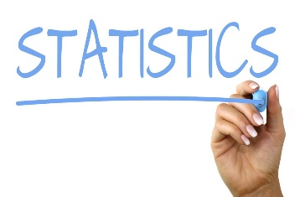
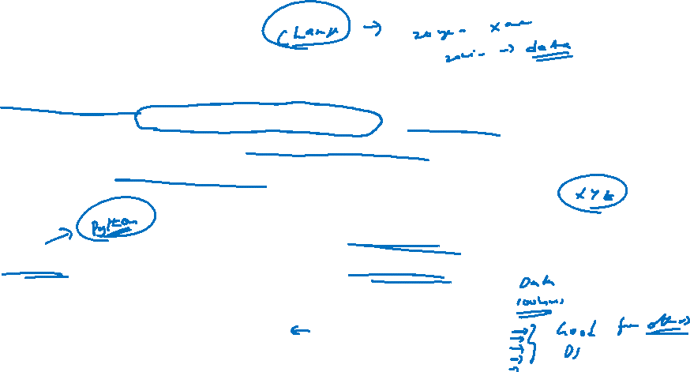
What is Statistics ?
Uncertainty is rampant ! we use statistics to answer questions about things that are unknown (e.g. : number of cars in Bangalore ?) , but just as importantly, we use statistics to get an idea of how sure we are of our answers. Sometimes it is useful to know that you don’t know.!!
Statistical tools are used to make most out of limited information!!

Slide 7

Terminology commonly used terminology in the discipline of statistics
Variable : A variable is defined as an attribute of an object of study. Choosing which variables to measure is central to good experimental design.
Ex : You are collecting data of weight of adults of male living in Australia, here our variable is weight
A Variables are things you measure, manipulate and control in statistics and research.
All studies analyze a variable, which can describe a person, place, thing or idea. A variable's value can change between groups or over time.
A variable can also be called as a data item
Another example : if the variable in an experiment is a person's eye color, its value can change from brown to blue to green from person to person.

Slide 8
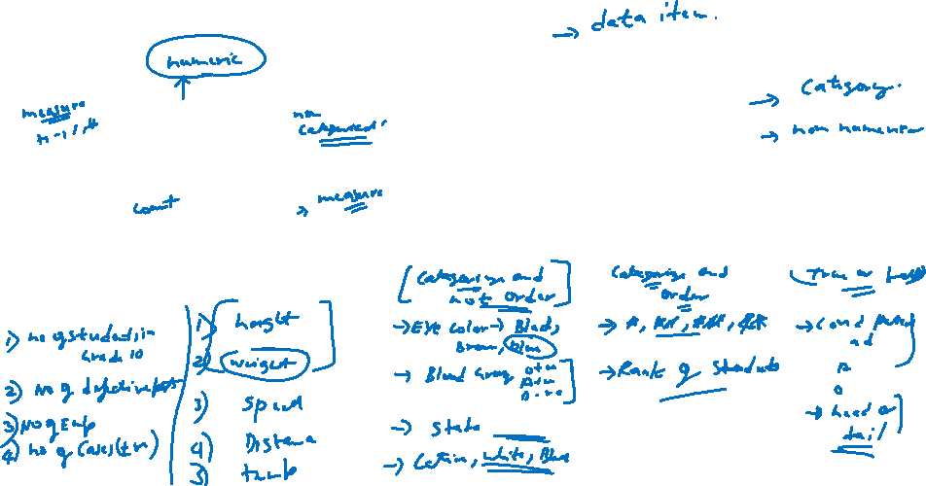
Types of Variables
Variable
Quantitative
Qualitative
Discrete
Continuous
Nominal
Ordinal
Binary
Ex:

Slide 9
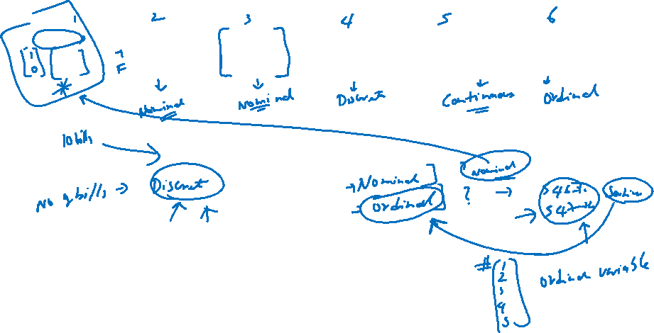
Quick exercise – Identify type of Data

Slide 10
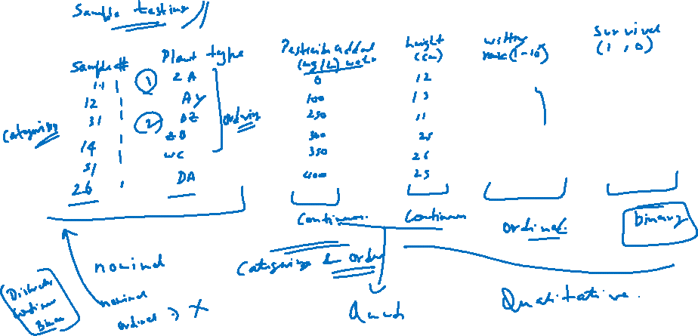
Worksheet

Slide 11
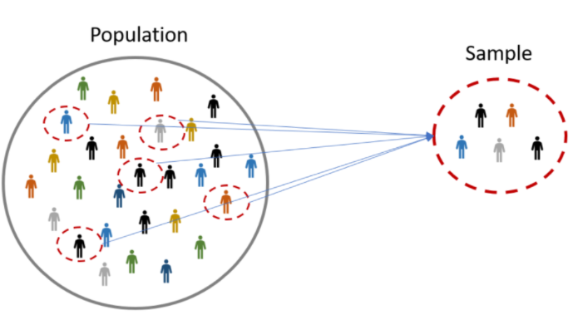


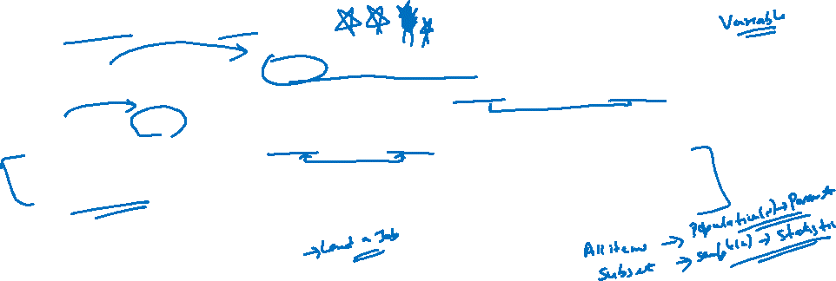
Population & Sample
A population is the collection of all items of interest to our study and is usually denoted with an uppercase N.. The numbers we've obtained when using a population are called parameters..
A sample is a subset of the population and is denoted with a lowercase n and the numbers we've obtained when working with the sample are called statistics.
Example : Let's say we want to perform a survey of the job prospects of the students studying in the New York University, what is the population?

Slide 12
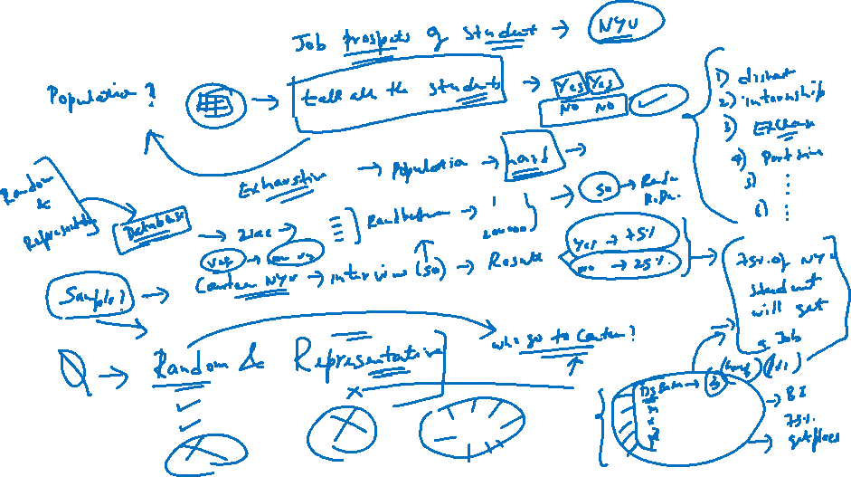
Worksheet

Slide 13
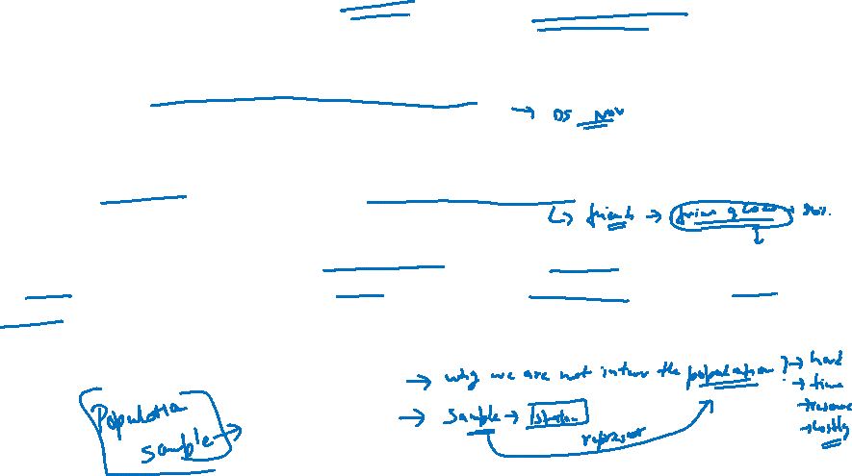
Why Sample should be Random & Representative?
Sampling involves selecting units from a population of interest such that the sampling units represent the whole population. If sample is bias the resultant statistics can bias and will not be representative.
Random sampling is one such procedure that selects a sample of units from a population by chance, typically to facilitate generalization from the sample to the population.
Random sampling ensures that results obtained from your sample should approximate what would have been obtained if the entire population had been measured. The simplest random sample allows all the units in the population to have an equal chance of being selected. Often in practice we rely on more complex sampling techniques.

Slide 14
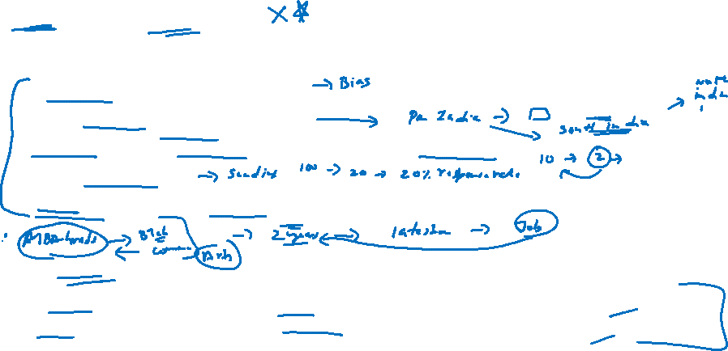
Bias in sampling :
There are five important potential sources of bias that should be considered when selecting a sample, irrespective of the method used. Sampling bias may be introduced when:
Any pre-agreed sampling rules are deviated from
People in hard-to-reach groups are omitted
Selected individuals are replaced with others, for example if they are difficult to contact
There are low response rates
An out-of-date list is used as the sample frame (for example, if it excludes people who have recently moved to an area)
Types of Sampling :
Probability sampling involves random selection, allowing you to make strong statistical inferences about the whole group.
Non-probability sampling involves non-random selection based on convenience or other criteria, allowing you to easily collect data.

Slide 15
Worksheet

Slide 16
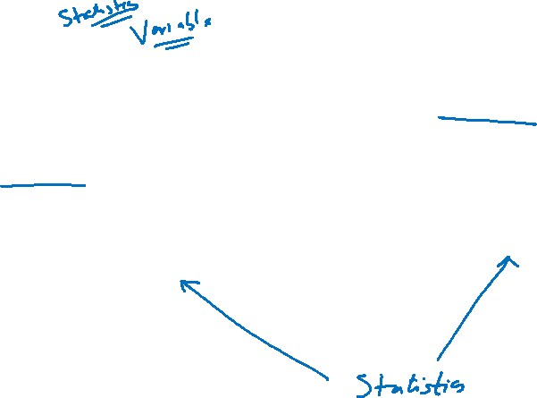
After understanding Population and Sample it opens the gate to understand what is Inferential and Descriptive statistics.

Slide 17
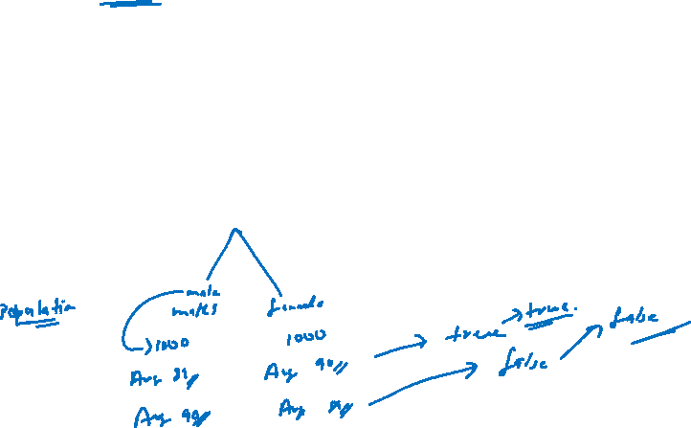
Inferential Statistics
The methods used to determine something about a population on the basics of a sample.
Inferential statistics allow you to test a hypothesis or assess whether your data is generalizable to the broader population.
Examples :
you want to know what factors can influence the decline in poverty. You use variables such as road length, economic growth, electrification ratio, number of teachers, number of medical personnel, etc.
We often hear the assumption that female students tend to have higher mathematical values than men. Is that right?

Slide 18
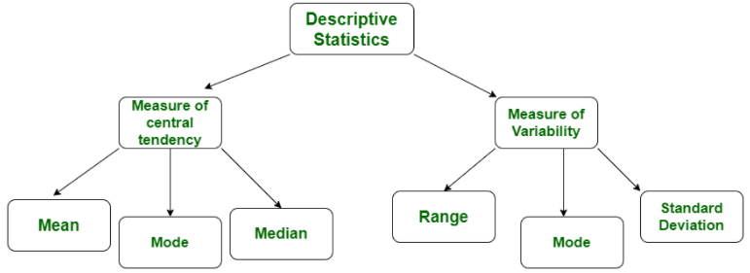

Descriptive Statistics
Descriptive statistics is a term given to the analysis of data that helps to describe, show and summarize data in a meaningful way. It is a simple way to describe our data.
Descriptive statistics is very important to present our raw data in effective/meaningful way using numerical calculations or graphs or tables. This type of statistics is applied on already known data.
Types of Descriptive Statistics
Measure of Central tendency
Measure of Variability
Examples :
you want to know what factors can influence the decline in poverty. You use variables such as road length, economic growth, electrification ratio, number of teachers, number of medical personnel, etc.

Slide 19
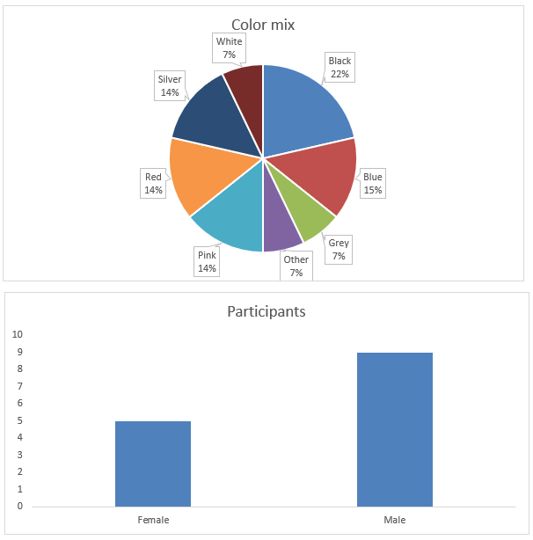
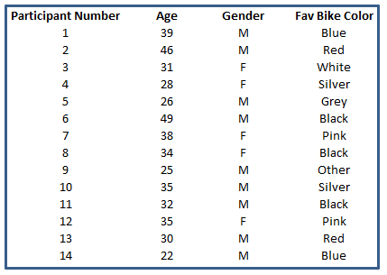
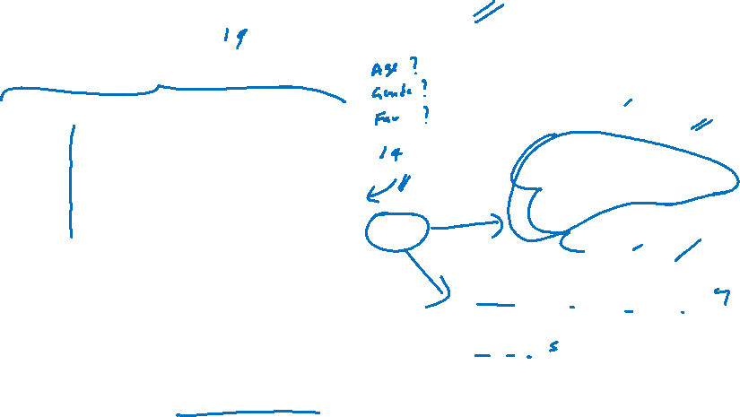
Descriptive Statistics – Example You’ve performed a survey to 40 respondents about their favorite car color. And now you have a spreadsheet with the results.
Descriptive statistics simply describes the data

Slide 20
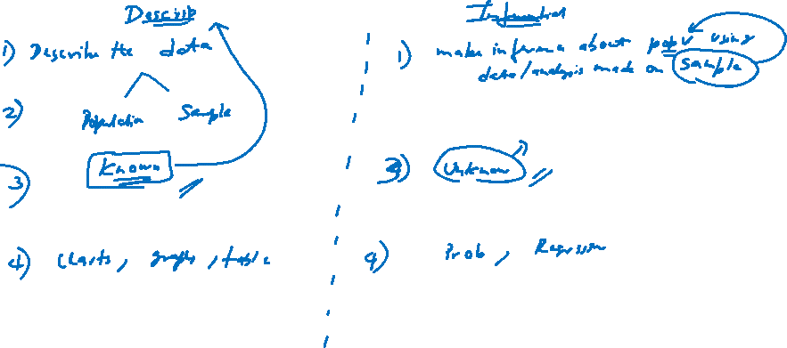
Difference between Descriptive & Inferential Statistics

Slide 21
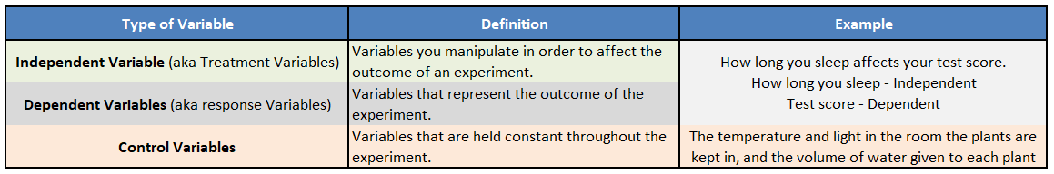
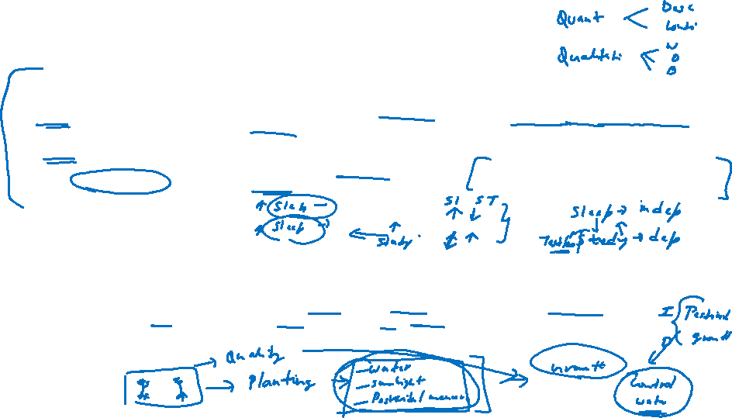
Independent, Dependent & Control variable
Importance of the Control Variables
Although control variables may not be measured as they are not recorded, yet they can have a significant effect on the outcome of an experiment.
Therefore, the lack of awareness of control variables may lead to faulty results or what is called “confounding variables”. So, recording control variables makes it easier to reproduce an experiment and to establish the relationship between the independent and dependent variables.
For example, suppose we are trying to determine whether a particular fertilizer influences plant growth. Here, the independent variable is the presence or absence of the fertilizer, whereas the dependent variable is the height of the plant or rate of growth.
If we don’t control the amount of light, for example, we perform some part of the experiment in the summer and some part during the winter, we may skew our results.

